Slide 1


Brokering an evidence base for community services to promote health and wellbeing
Janet Harris, Reader in Knowledge Mobilisation
School of Health & Related Research (ScHARR)

Slide 2
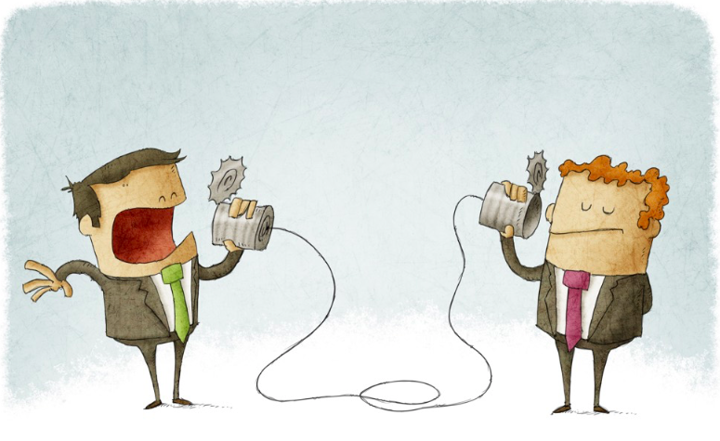
The problem
Shifting non-medical needs from primary care to community e.g. Life Navigators, Link Workers, Community Support workers. and more recently Social Prescribing.
We can’t shift any more resource from acute care to community unless you show us the evidence
Our community organisations aren’t adequately funded for the demand!

Slide 3

Contested knowledge
“We could wallpaper the town hall with stories, we need hard evidence”
We have lots of client stories, here’s our evidence.

Slide 4
What is “good enough” evidence?
A two-part question
How can we produce credible evidence for
The impact for community-based services?
The influence of knowledge brokering on the process?
Notes:
NIHR Fellowship expects data on both the changes made and the process of KM (reflexivity)

Slide 5
The deliverables
Working across community, government, health and academic sectors, we will produce
Community
Commissioning
A set of client-valued outcomes
Methods for evaluating process and impact that are appropriate in community settings
Monitoring and evaluation systems that are embedded in community organisations
A set of outcomes that can be used to justify a shift in investment
Credible methods for assessing impact
Knowledge that can be used to inform the modification of funding specifications
Notes:
Contentious

Slide 6






Researching the process of getting there
Conversation
Dialogic organisational development
Emergent collaborations
Partnership Working
Collective sensemaking
Participatory transdisciplinary research
Deliberative dialogue
Notes:
The following concepts and constructs were brought together to develop a preliminary theory of what might work in terms of Brokering the development of an evidence base:
Conversation: Being able to spend enough time with other people to be able to see the issue through their lens (Nonaka)
DOD: Conversations can be turned into wider dialogue within and across in organisations, informally mobilising people to recognise issues and take action to evidence and develop a service (Bushe)
Participatory research uses all of the methods used in “traditional” research, within a paradigm that the people who are the subjects of the research are also those who conduct it (ICPHR)
Transdisciplinary research proposes that getting people who have different perspectives together can help to solve messy and complex problems, IF the process is facilitated in a participatory way (Bushe)
Deliberative dialogue is a promising approach to surfacing different interpretations of evidence, finding out what commissioners and policymakers value in relation to what local people see as what works (different interpretations of what constitutes evidence within a decision making context) (Lomas – and others)
Collective sensemaking is a phrase coined by Carl Wieke, who said that people need to interact in order to make sense of the world and decide what evidence actually means in a real life environment.
Emergent collaborations are being researched by people such as Spekkink & Cole, to identify what brings together organisations that would normally operate in separate spheres.
Partnership working has been the focus of some major research over the past 8 years, which has found that all of the above processes are important in gaining commitment to work together to solve a problem.

Slide 7
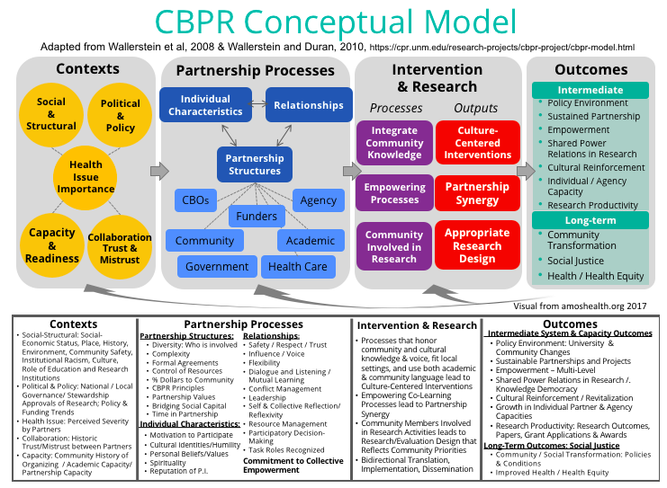
Validated model for Partnership working

Slide 8
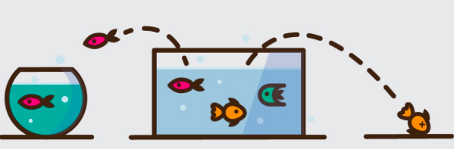
The actors….
Cross sector sponsors (in theory)
Government
Local Authority
Health Service
Sheffield CCG
Participatory Domain
University
of Sheffield (ScHARR)
Voluntary sector
SOAR
MCDT
Notes:
Organisational sponsorship is not a permanent given!!
Participatory domain was a speck in the first instance
LA PH support changed from CWB to Director of PH
ScHARR in parentheses because university connections with city are poor – and there is little recognition of the value of participatory approaches
VCF sector formal sponsors but support form other anchors as well
CCG churn and turnover of DIrector

Slide 9
Where to start… windows of opportunity?
Government
Local Authority
Health Service
Sheffield CCG
Participatory Domain
University
of Sheffield (ScHARR)
Voluntary sector
SOAR
MCDT
Notes:
Organisational sponsorship may be there in theory but is not permanent!!
Who already works together? Participatory domain was a speck in the first instance
CHURN: LA PH support changed from CWB to Director of PH
ScHARR in parentheses because university connections with city are poor – and there is little recognition of the value of participatory approaches
VCF sector formal sponsors but support form other anchors as well
CCG churn and turnover of DIrector

Slide 10
Establishing relationships in the community sector
Project by project: Year 1
Deep dive
Sponsors
People Keeping Well in the Community
City wide impact evaluation
Darnall Wellbeing
SOAR
MCDT
Word of mouth referral: Year 2
Disability Sheffield
Timebuilders
Co:Create South Yorkshire HA
(18 projects)
Word of mouth referral: Year 3
Be Cancer Safe (5 cities South Yorkshire)
Notes:
Conversation: How do you want to evidence what you do? Are you able to evidence it – Skills? Capacity?
DOD: Can interest and motivation be created with workers and volunteers? With clients? With the Board?

Slide 11

Establishing relationships in communities – Project by project
Emergent collaborations
Collective sensemaking
Deliberative dialogue
Participatory transdisciplinary research
Dialogic organisational development
Conversation
Notes:
Conversation: How do you want to evidence what you do? Are you able to evidence it – Skills? Capacity?
DOD: Can interest and motivation be created with workers and volunteers? With clients? With the Board?
PTDR: How can uni work with VCF to co-create evidence?
DD: Who wants to measure what, and in what way? (Collaborative development of measures and tools)
CS: What does this data actually mean? How do we link it with stories?
EC: How do we want to work together next?

Slide 12
Example: The SOAR evaluation
Partnership Working: Board support and investment in worker-developed evaluation
Data that informs individual practice and organisational level
Emergent collaborations
What Works Wellbeing is measuring the wrong things
Collective sensemaking
Deliberative dialogue
What information will help our clients? Help us workers?
We’re here to work with people, not forms
Participatory tool development
Organisational attitudes
Funding is shrinking
concerns
Notes:
Conversation: How do you want to evidence what you do? Are you able to evidence it – Skills? Capacity?
DOD: Can interest and motivation be created with workers and volunteers? With clients? With the Board?

Slide 13
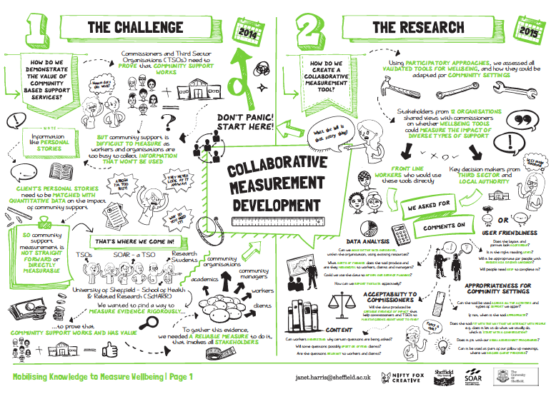
Describing SOAR evaluation methods
Describing the methods in story format makes it more accessible and people feel proud of their work
Notes:
Tweeted by commissioners

Slide 14
Creating a space for collective sensemaking
Knowledge space
Bringing communities together to share How, for whom, where, why does community support work?
SOAR
People Keeping Well in the Community
MCDT
Zest
Shipshape
Voluntary Action
Sheffield
Notes:
Inviting people to gneral sharing events is less threatening that expecting them to start working together. It’s a precursor. In these eveents, it’s important to avoid lectures or academic presentations. Get co-evaluators to present whenever possible. Ask them to speak about the challenges, not just the successes. Make the events very interactive from theb eginning, to set expectations for poarticiaption.

Slide 15

Brokering the knowledge

Slide 16
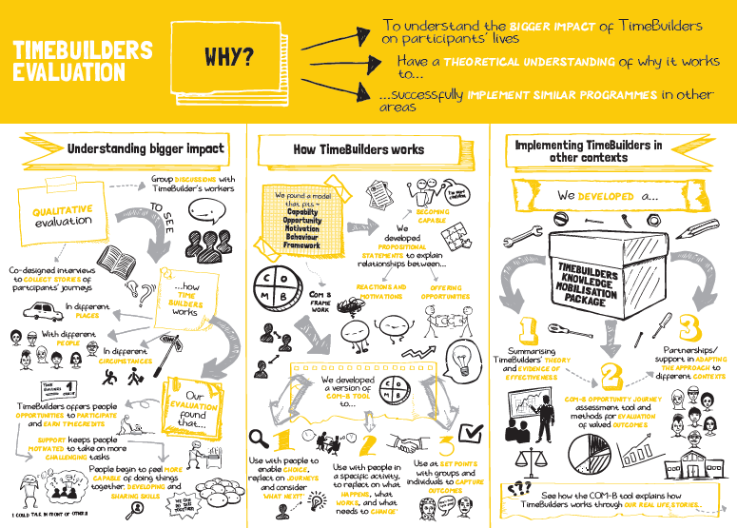
Using different methods changes the interaction

Slide 17
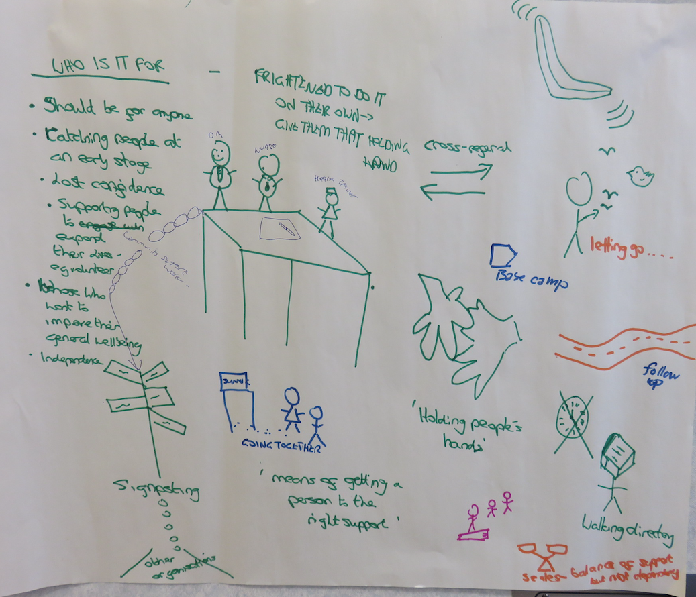
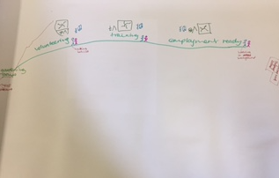
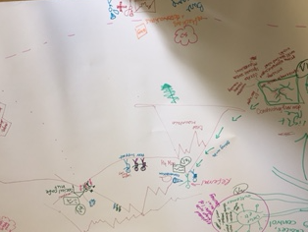
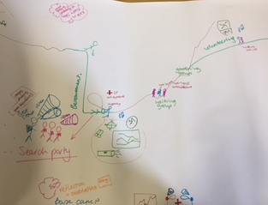
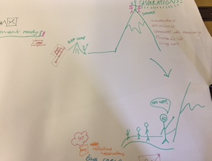
Constructing the story

Slide 18
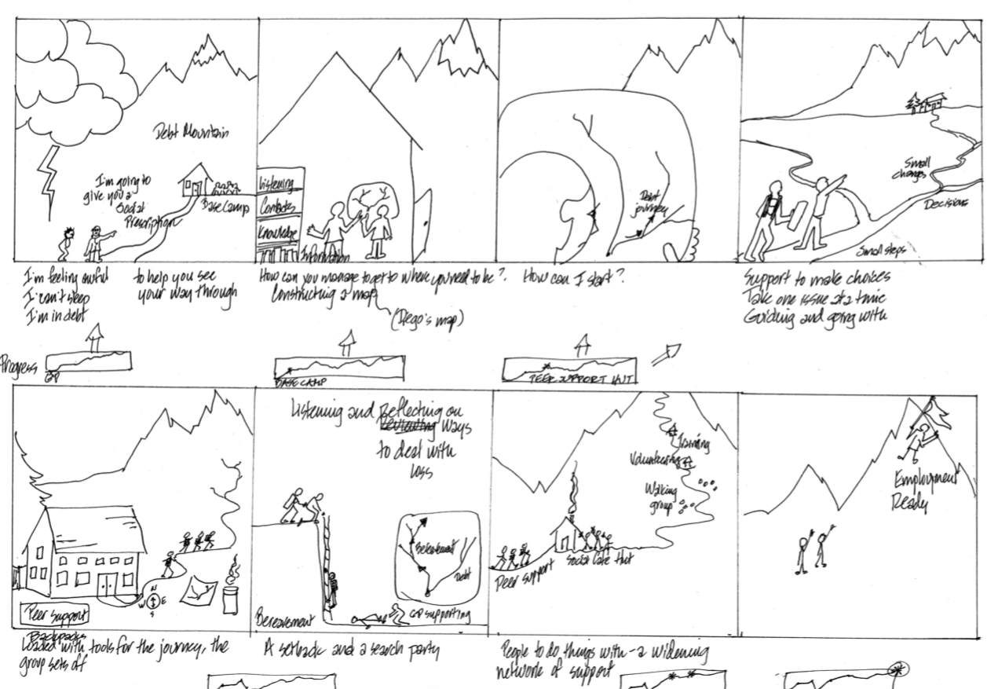
Co-created storyboard

Slide 19
Emergent collaborations
Shipshape
People Keeping Well in the Community
Knowledge space
Bringing communities together to share How, for whom, where, why does community support work?
SOAR
MCDT
Zest
Voluntary Action
Sheffield
Organisations have shared values and a similar approach to provision that produces the same outcomes across different settings and circumstances
Notes:
Inviting people to gneral sharing events is less threatening that expecting them to start working together. It’s a precursor. In these eveents, it’s important to avoid lectures or academic presentations. Get co-evaluators to present whenever possible. Ask them to speak about the challenges, not just the successes. Make the events very interactive from theb eginning, to set expectations for poarticiaption.

Slide 20

Collective voice and action by community organisations:
“This never would have happened without…”

Slide 21
Bringing those with more or less credible evidence into a neutral knowledge space
Fellowship Sponsors
Voluntary Action Sheffield Community organisations
Participatory evaluation training
Co-production learning event
Engaged learning event
University Social Accountability
Local Authority
University Engaged Learning Group
NHS CCG
Notes:
Inviting people to gneral sharing events is less threatening that expecting them to start working together. It’s a precursor. In these eveents, it’s important to avoid lectures or academic presentations. Get co-evaluators to present whenever possible. Ask them to speak about the challenges, not just the successes. Make the events very interactive from theb eginning, to set expectations for poarticiaption.

Slide 22
Progress to date
Scientific discourse:
  Current methods of measuring wellbeing and health are inappropriate for communities
Social discourse:
  There is an emerging consensus on what works on a qualitative and experiential level across organisations (locally and nationally)
Community organisations are developing a collective voice about evidence issues
Across sectors, there is agreement that policy for shifting to communities was introduced without mapping capacity
Agreement across sectors to develop a common data set and use it to develop a capacity model
LA, CCG, university, communities have dedicated resources to the project
“Proof of concept” evaluation being conducted
Capacity modelling being designed by LA anduniversity

Slide 23

Are we going to end up with a consensus space?

Slide 24
How can we produce credible evidence for
The influence of knowledge brokering on the process?
Progress to date
Did co-creation occur within each project (within case analysis)?
Has the participatory approach:
  Enabled people to see knowledge through the eyes of another (Knowledge sharing)?
  Engaged different people in the organisation and surfaced development issues (Dialogic OD)?
  Led to different people with different skills to work together tp develop methods for creating an evidence base (TDR)?
  Inspired deliberative dialogue and disagreement most appropriate methods for creating an evidence base, about client-valued outcomes versus commissioner-valued outcomes (Deliberative dialogue)?
  Moved towards a collective understanding of how to analysing what the evidence means? (Collective sensemaking)
  Motivated people to identify the added value in working together (Emergent collaborations)?
  Produced a commitment to complete a an evaluation, which is sustained in spite of competing demands on time (Partnership working)?
  Led to mobilisation of evaluation knowledge, in terms of informing policy decisions, changing funding specifications, changing commissioning requirements for monitoring and evaluating impact?
Cross-case analysis: Do participatory approaches to knowledge mobilisation work, for which types of projects and participants, in what sort of circumstances and at what point in time?

Slide 25
What next? The development of university/community partnerships
Finding Solutions:
How the 4 sectors
work together
Co-create an evidence base for community services?
Teaching and Learning?
Research?
Impact?
Volunteering?
Medical Faculty Social Accountability Steering Group

Slide 26
Thank you

Slide 27
Thank you to
Sponsors: SOAR, Manor & Castle Development Trust, Sheffield City Council Public Health & Adult Social Care, NHS CCG, ScHARR
Steering Groups: University of Sheffield Social Accountability; CCG Health Inequalities
Boards: SOAR, Darnall Wellbeing
Co-researchers: Voluntary Action Sheffield; Disability Sheffield, South Yorkshire Housing Association, People Keeping Well I n the Community
Workers and volunteers across Sheffield who have given generously of their time to learn and co-create the research

Slide 28

Acknowledgments – The Noun Project
barracuda
Augusto Serquiz
Asianson.design
Miguel C Balandrano
Artem Kovyazim
Aldric Rodriguez
Agnes Bonmati
Gregor Cresnar
Annette Spithoven

Slide 29
References
Abma, T. A., Cook, T., Rämgård, M., Kleba, E., Harris, J., & Wallerstein, N. (2017). Social impact of participatory health research: collaborative non-linear processes of knowledge mobilization. Educational Action Research, 1-17.
Bushe, G. R., & Marshak, R. J. (2014). Dialogic organization development. The NTL handbook of organization development and change, 193-211.
Bergmann, M., Jahn, T., Knobloch, T., Krohn, W., Pohl, C., & Schramm, E. (2012). Methods for transdisciplinary research: a primer for practice. Campus Verlag.
Belone, L., Lucero, J. E., Duran, B., Tafoya, G., Baker, E. A., Chan, D., ... & Wallerstein, N. (2016). Community-based participatory research conceptual model: Community partner consultation and face validity. Qualitative Health Research, 26(1), 117-135.
Boyko, J. A., Lavis, J. N., Abelson, J., Dobbins, M., & Carter, N. (2012). Deliberative dialogues as a mechanism for knowledge translation and exchange in health systems decision-making. Social Science & Medicine, 75(11), 1938-1945.
Davies R. & Dart J. (2005) The most significatn change technique. Aguide to its use. https://www.kepa.fi/tiedostot/most-significant-change-guide.pdf
Harris, J. The challenges of reviewing participation in health research. (2018) In Wright, M. and Kongats, K. (eds) Participatory Health Research: Voices from around the world. Springer Publishing.
Harris, J., Cook, T., Gibbs, L., Oetzel, J., Salsberg, J., Shinn, C., Springett, J., Wallerstein, N., & Wright, M. (2018). Searching for the Impact of Participation in Health and Health Research: Challenges and Methods. BioMed Research International https://doi.org/10.1155/2018/9427452
Harris, J., Springett, J., Croot, L., Thompson, J. (2016) How stakeholder participation can contribute to systematic reviews of complex interventions. Journal of Epidemiology & Community Health, 70:207-214
Harris, J., Springett, J., Booth, A., Croot, E., Campbell, F., Thompson, J., Goyder, E., VanCleemput, P., Wilkins, E., & Yang, Y. (2015) Can community-based peer support promote health literacy and reduce inequalities? A realist review. Public Health Research, 3(3).
International Collaboration fir Participatory Health Research (2015). What is Participatory Health Research? Position Paper 1. http://www.icphr.org/position-papers
International Collaboration fir Participatory Health Research (forthcoming). What is Impact in Participatory Health Research? Position Paper 3. (Forthcoming) http://www.icphr.org/position-papers
Jean-Louis, D., & Lomas, J. (2003). Convergent evolution: the academic and policy roots of collaborative research. Journal of health services research & policy, 8, S1Lucero, J., Wallerstein, N., Duran, B., Alegria, M., Greene-Moton, E., Israel, B., ... & Schulz, A. (2018). Development of a mixed methods investigation of process and outcomes of community-based participatory research. Journal of mixed methods research, 12(1), 55-74.
Nonaka, L., Takeuchi, H., & Umemoto, K. (1996). A theory of organizational knowledge creation. International Journal of Technology Management, 11(7-8), 833-845.
Spekkink, W. A., & Boons, F. A. (2015). The emergence of collaborations. Journal of Public Administration Research and Theory, 26(4), 613-630.
Wieck KE.(1995) Sensemaking in organisations. Sage.

