Slide 1
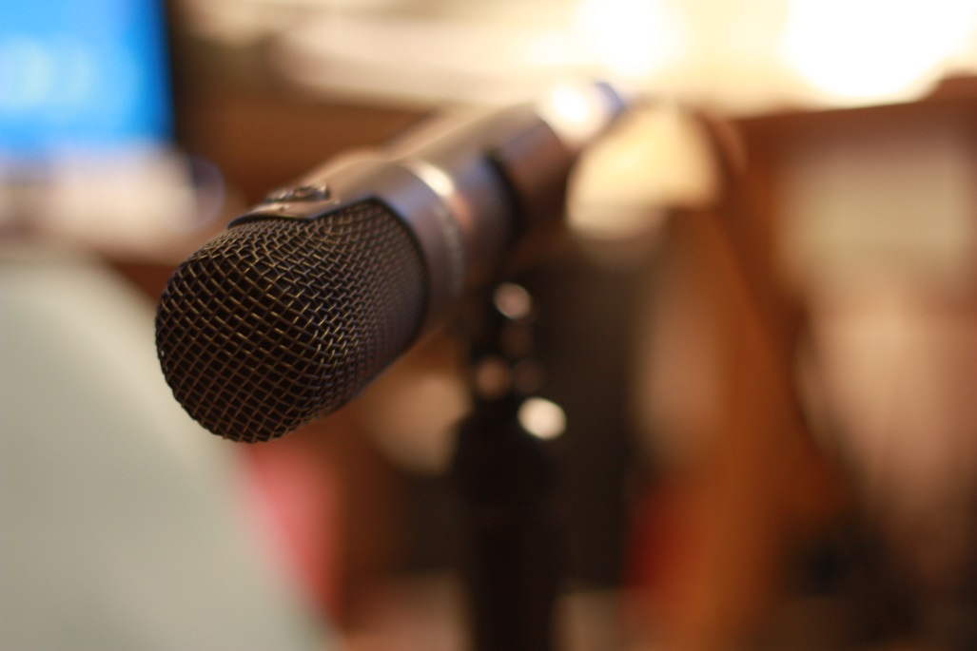
Making an
Impact
with
Podcasting
Jane Reck: Reckord Media

Slide 2
My Work
BBC freelance radio producer
Podcaster and audio slide-show producer
Podcast production training courses
Media training courses
Radio and podcast script writing
Case study and feature writing
Oral history recording and research

Slide 3
My Background
BBC Network Radio (R4,R2,R5live)
UK Research Councils
Transport Systems Catapult
UK Universities, Open University
British Library, National Gallery
EPSRC Press Officer/ Podcaster/ Writer – case studies and features
BBC Regional Radio Journalist
BBC trained news journalist
Historian

Slide 4
Podcasting as a PR Tool – why do it?
A raised profile helps to attract funding/ students/ academic and industrial partners/ visitors.
A platform for the achievements/ potential of your research
Gives you control of the messages you want to convey
Informs public opinion and government policy.
Highlights areas of need/ concern/ importance/ interest/ public debate.
To inspire the next generation (of researchers etc..)
Raises your individual profile as a communicator
Because your work is important and makes a difference.

Slide 5
Podcasting as a PR tool to engage with….
Industry
Academia
Government
The Public
Funding Organisations, Charities e.t.c.
The Media

Slide 6
Overview
What is Podcasting?
Using podcasting to engage with the Public, Academia, Industry, Government and The Media
The equipment you need
Recording audio – the basics
Interview preparation and technique
Putting your podcast online
Scripting a podcast narrative
Using sound effects and music

Slide 7
Clear, Accessible, Jargon–free
Communication
If you want to be understood
speak in the language
of your audience

Slide 8
Podcasting as a PR tool -The ‘So What’ factor
Include one or more of the following ingredients
What is new or unusual, really interesting about this (research,
initiative, event , lecture etc...)?
Is it cutting-edge, world leading, a world first etc….?
How will (or could) people/ society/ the economy benefit?)
What key things will (or could) come out of this (e.g. new
knowledge, technology, trained people, products, services)?
Why is it needed or what problem will (or could) it solve?
Why should people care about this?
Lecture/ Publication of a Paper – what do I want to get across?

Slide 9
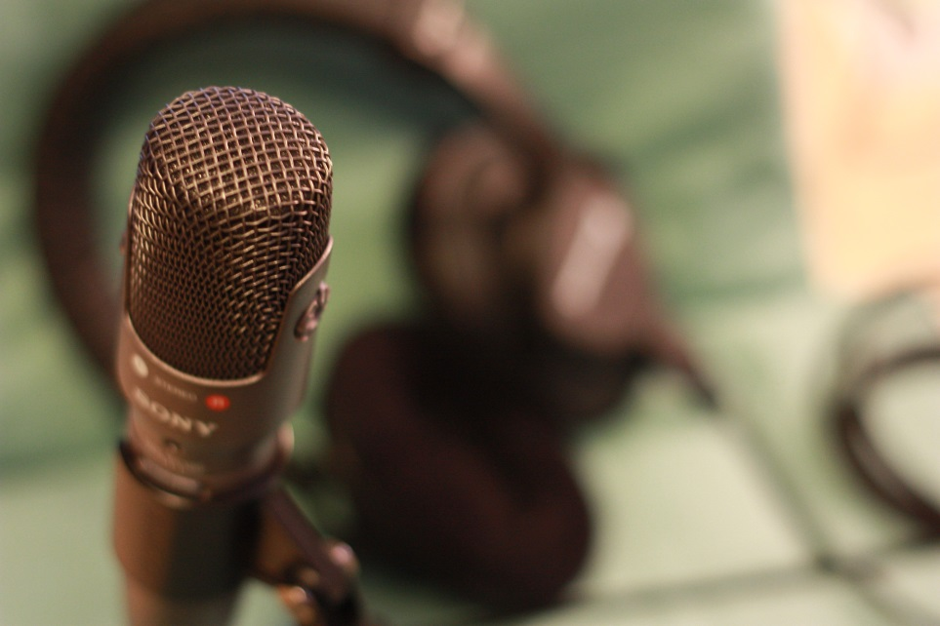
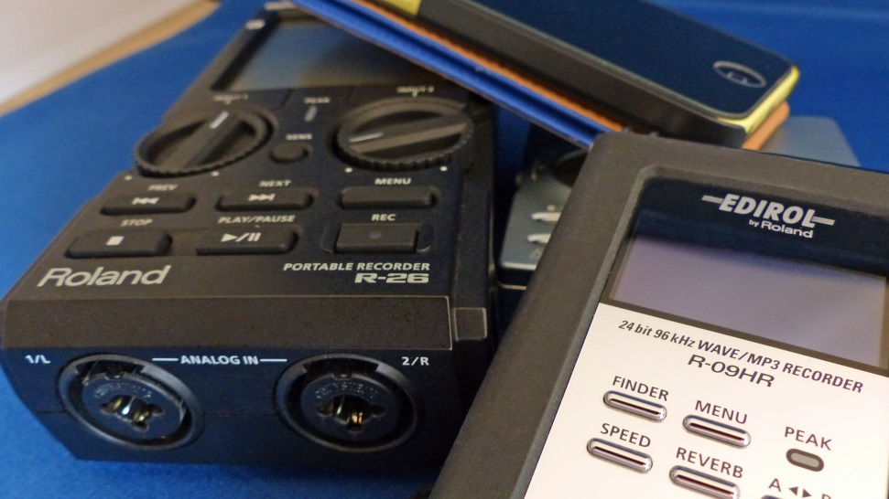
The equipment you need
Digital Audio Recorder
Microphone
Headphones
Audio digital editing software
Digital camera (optional)
A host site for your podcast
Thought, Planning, Time and Elbow Grease

Slide 10

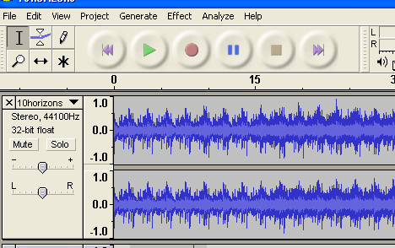
Digital Editing Software

Slide 11

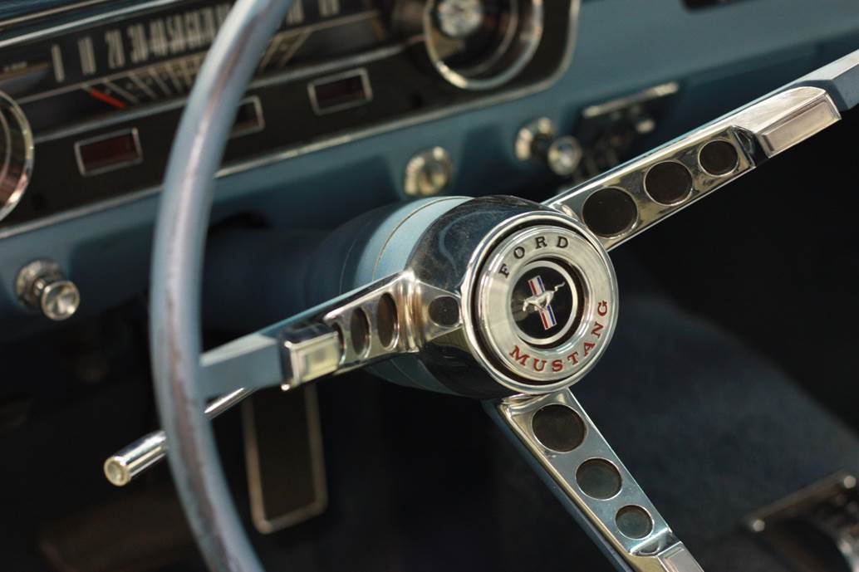
Digital Camera

Slide 12




A Host Site

Slide 13
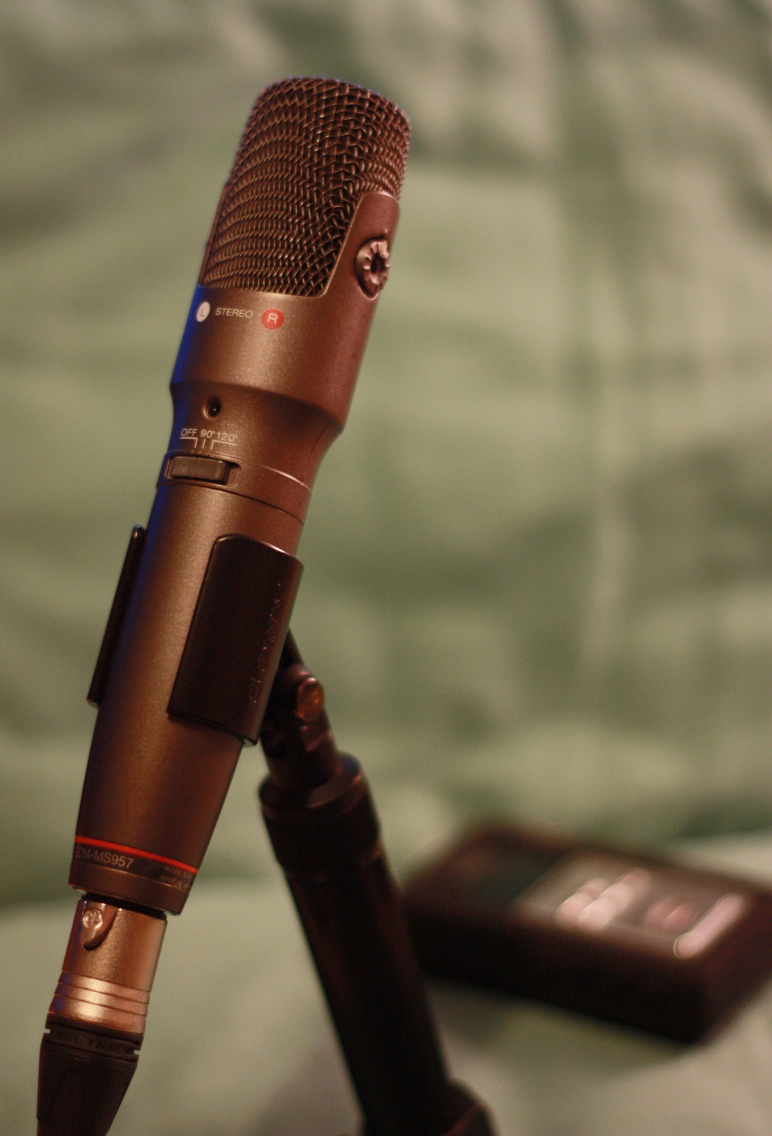

Recording Audio
– The Basics
Interview Preparation
and Technique

Slide 14
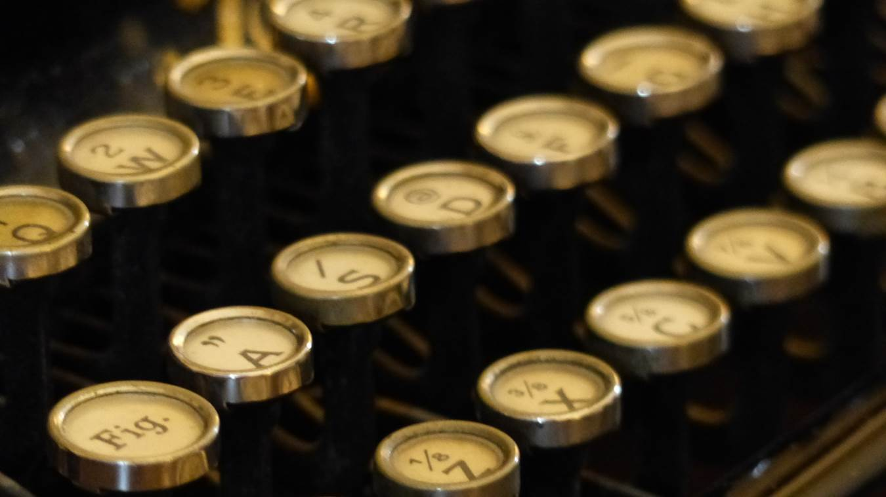

Scripting a
Podcast
Narrative
Using Sound Effects
and Music

Slide 15
Jane Reck
Reckord Media
Podcast and Radio Programme Production
Media Training
Podcast and Radio Production Training
Writing – case studies, news articles and scripts
Oral history work – recording, research, digital archiving
www.reckordmedia.com

