Slide 1

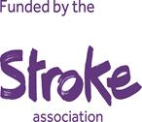

Development and Evaluation of a Group-Based Singing Intervention for People with Aphasia (the “SPA” trial)
raff calitri, Mary carter, sarah G. dean, rod S. taylor, fiona warren, anne spencer, jane adamsoN, paolo landa, chris code, Mark tarrant
The National Institute for Health Research (NIHR) Collaboration for Leadership in Applied Health Research and Care South West Peninsula at the Royal Devon and Exeter NHS Foundation Trust
also supported this work but views expressed are those of the author(s) and not necessarily those of the NHS, the NIHR or the Department of Health.

Slide 2

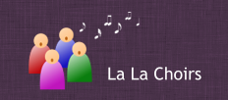
Acknowledgements
The Stroke Association (TSA 2016/04)
Plymouth Music Zone (PMZ)
La La Choirs

Slide 3
Aphasia after stroke
152,000 people affected by stroke each year in UK; 33% have aphasia
Around 6,000 people in Devon
Language disorder impacting gesture, reading/writing, expression, comprehension
Psychosocial ill-health
Loss of connections: social participation, isolation, confidence, depression
Improvements in language don’t always translate to improvements in psychosocial health
Lack of opportunities for PWA – lack of confidence can make these inaccessible

Slide 4


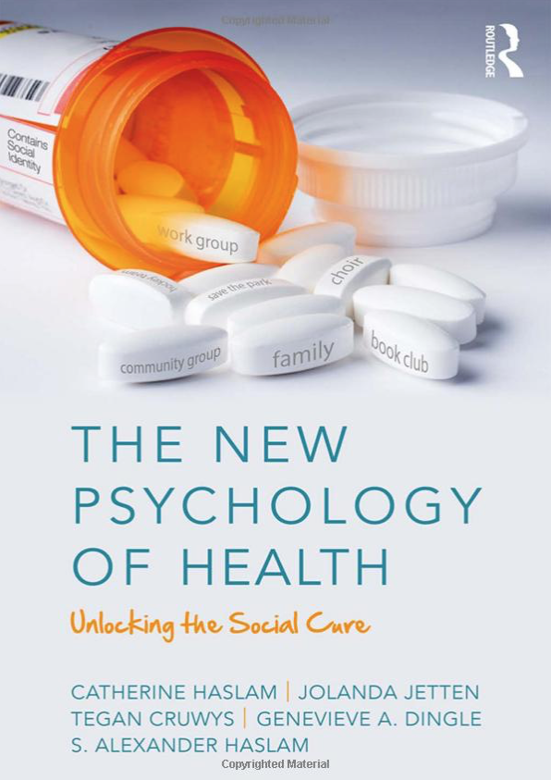
Arts and health
Increasing number of singing groups for people with long-term conditions
E.g., Parkinson’s, dementia
Reflects growing interest in “arts-for-health”
And more general move towards group-based treatment
Limited evidence for effectiveness or cost-effectiveness
BUT, group-based social connections recognised as important
The group as part of “the cure”

Slide 5
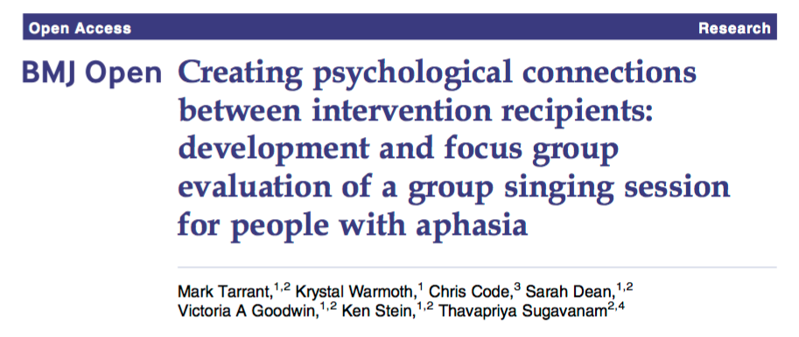
Singing for People with Aphasia
PenCLAHRC research-prioritisation process
Patient-generated question: “Might group singing improve the health of PWA?”
The journey to funding:
Project team
PPI & PenCLAHRC SSU group
Stakeholder meetings (SLTs, aphasia experts)
Failed funding bids!
Development study
August 2016: funding from Stroke Association
Project started April 2017

Slide 6

The SPA trial
Pilot randomised controlled trial of a group singing intervention to improve wellbeing
SPA aims to improve psychosocial health of people with post-stroke aphasia
And explores possible change/improvement in communication
This pilot study assesses the feasibility of conducting a definitive RCT and aims to inform its design
Is SPA feasible and acceptable to participants?
Can we recruit and retain participants?
Can we collect outcome measures at different assessment points?
How well can the intervention be delivered in different locations, with different groups?
What are the likely mechanisms of action underpinning the intervention?
ClinicalTrials.gov NCT03076736

Slide 7
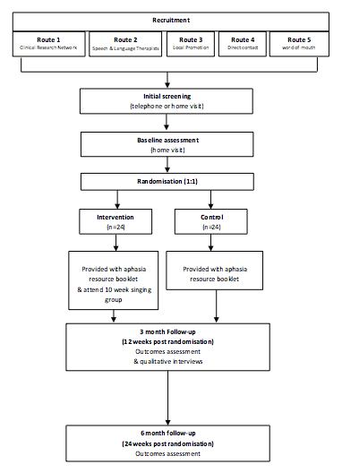
The SPA trial: Design
2-group, assessor-blinded, randomised controlled external pilot trial with parallel mixed methods process evaluation and economic evaluation
Individual randomisation, 1:1, to SPA or control
Control: Resource booklet only
Living with aphasia; community opportunities
SPA: 10-week singing programme and resource booklet
Target sample size: 48 (24 per arm)
Three cohorts – Newton Abbot, Plymouth, Exeter
3-mth & 6-mth follow up

Slide 8
The SPA trial: Intervention development
Co-created with partners (health researchers, stroke survivors, singing facilitators, PMZ, SLTs)
Participatory design
SPA combines group singing with behaviour change techniques to support psychosocial skills
Information-Motivation-Behavioural skills model of health behaviour change to support individuals in (re-)developing social skills and confidence needed to improve psychosocial outcomes (Fisher et al., 2003)
E.g., Information about benefits of participating; providing positive feedback; self-monitoring
Development study informed techniques for building group dynamic (“group cohesiveness”)
Using collective language; formulating group norms; goal setting; group name; singing “champion”
See also MAGI framework*
*Borek A, Smith JR, Greaves CJ, Gillison F, Tarrant M, Morgan-Trimmer S, McCabe R, Abraham C. Developing and applying a framework to identify and understand “Mechanisms of Action in
Group-based Interventions” (MAGI): A mixed-methods study. Efficacy & Mechanism Evaluation, in press.

Slide 9
The SPA trial: Recruitment
Inclusion criteria:
Aphasia diagnosis after a stroke (referring clinician; trial SLT; medical records)
Willing to be randomised
Pre-stroke conversational English
Capacity to consent
Exclusion criteria:
<18 years
Currently engaged in SLT programme
Intending to relocate outside the geographical region
Participating in another group intervention study / attending another singing group
Recruitment supported by: CRN, local SLTs, advertising, media, word of mouth

Slide 10
The SPA trial: Outcome assessments
Outcome measures (baseline, 3-month, 6-month)
SAQOL-39: 39-item health-related quality of life (stroke and aphasia)^{1,2,3}
mRNL (modified Reintegration to Normal Living): 11-item measure of social participation^{1,2,3}
ICECAP-A: 5-item measure of capability (economic evaluation) ^{1,2,3}
EQ-5D-5L: 6-item measure of health-related QoL (cost utility analysis) ^{1,2,3}
COAST (Communication Outcome After STroke): 20-item measure of communication^{1,3}
Very Short Version of the MAT: diagnostic tool to identify aphasia type^{1,3}
Service Receipt Inventory: types and amount of use of health and social care resources^{1,3}
CarerQoL-7D (Care related Quality of Life): 7-item measure of impact of providing care^{1,3}
Adverse incidents^{2,3}
¹ baseline; ² 3-mths; ³ 6-mths

Slide 11
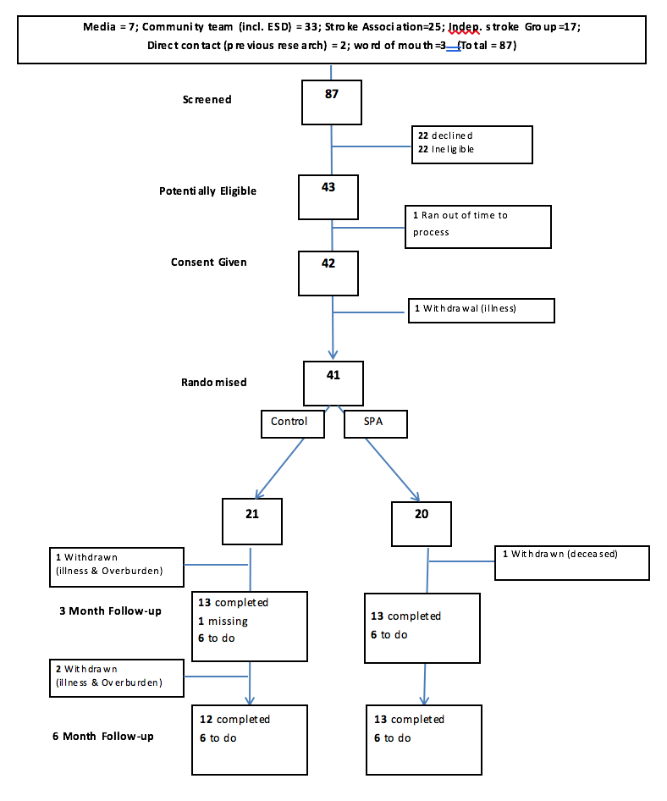
The SPA trial: Current status
Cohort 1 finished
Cohort 2 finished
Cohort 3 in 3mth follow-up
Recruitment challenges
Under-recruited (N=41) but retention is high and sufficient for sample size calculations for definitive RCT
Retention: 38/41 (93%); very few drop-outs or loss to follow up so far
See our poster today for more

Slide 12
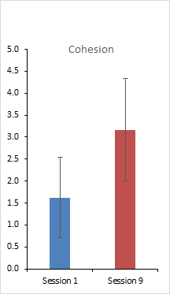
The SPA trial: Current status
Early process evaluation work indicates groups are bonding as anticipated
Video analysis of group cohesiveness across the singing programme
Interviews with Ps support this:
Feelings of affinity; enjoying doing things with others
Indicates the basis for delivery of key behaviour change mechanisms
Towards a model for delivering group-based interventions

Slide 13
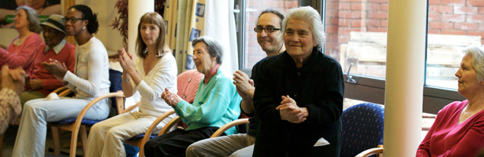
Thank you
Mark Tarrant (m.tarrant@exeter.ac.uk)
Project webpage: http://clahrc-peninsula.nihr.ac.uk/research/group-singing-for-aphasia

